Slide 1
WELCOME!!
Creek Bridge STEM Academy
6th, 7th, and 8th grade
Virtual ELA
Mrs. Sydni Lewis

Slide 2
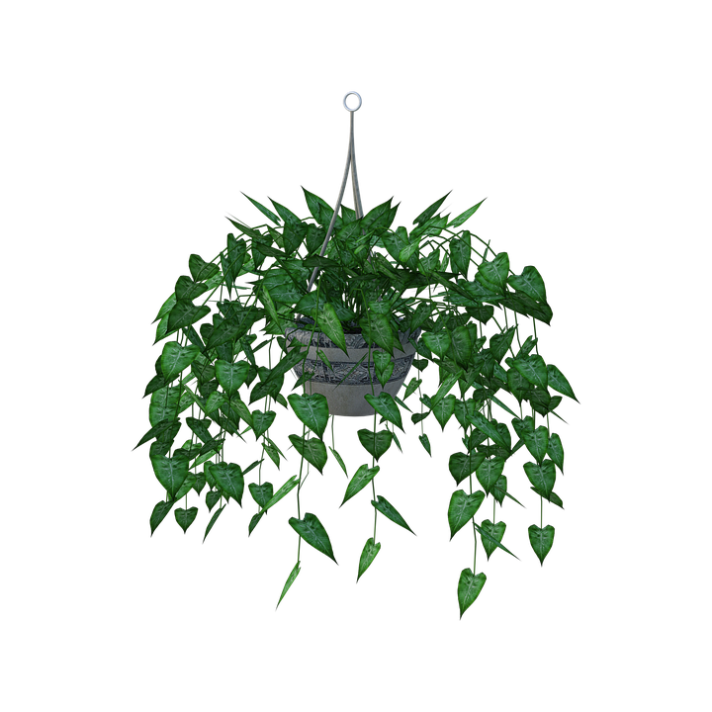
My name is Mrs. Sydni Lewis and I will be teaching you this year (many of you already know me). This school year will be VERY DIFFERENT, but I’m excited to go on this journey with you!
In case you don’t know, I am a newlywed (been married one year) and just bought a house LAST WEEK! I enjoy reading, writing, and spending time with my husband, and am going to attempt to start gardening!

Slide 3
More About Me
I’m a self-described nerd. :)
My Master’s degree is in Guidance and Counseling
My Bachelor’s degree is in Middle Level ELA/SS
I taught 6th and 7th grade ELA for the second semester at CBSA last school year.
Lucky number 7! This will be my 7th year of teaching (2nd year at CBSA)

Slide 4
ELA Units/Themes for this year
6th grade:
1. Facing Fear
2. Animal Intelligence
3. Myths and Folktales
4. Making your voice heard
7th grade:
1. Bold Actions
2. Perception vs. Reality
3. Nature at work/Risks & Exploration
4. Guided by a Cause
8th Grade:
1. Who am I?
2.The Thrill of Horror
3. Freedom
4. The Value of Work

Slide 5
Let’s keep in touch! Contact Me.
Mrs. Sydni Lewis
6th, 7th, and 8th grade Virtual ELA
(843) 362-3500 Ext. 4226
sylewis@marion.k12.sc.us.
You can also contact me on Teams! I can and will host virtual individual meetings by appointment.

